Slide 1
Predicting Prospective Learner Success & Persistence at point of Inquiry (Learner Success Model) (Mar 2013)
Opoku Adu-Gyamfi
Marketing Analytics

Slide 2
About Learner Success Model(LSM)
The Learner success model (LSM) is an attempt to predict prospective learner’s likelihood of succeeding and persisting through graduation at the point of inquiry
Learners’ success and persistence is perceived as a person’s ability to succeed and complete certain threshold of prescribe course sequence in an academic program
The model is an equation with a finite number of input attributes that assign prospective leaner a score ranging between 0 to 100, the higher the score, the better the prospect learner.
Attributes on inquiries coming through our inquiry systems (Seahawk) are collected and routed through the model to assign a score
The model was developed and implemented the beginning of third quarter of 2011. The model is due for update as it’s approaches it’s life span (18-24months)

Slide 3
Cont’d: About Learner Success Model(LSM)
The model as is right now is relevant to inquiries from continental USA as it include credit bureau data and other Zip code level aggregates applicable to only US residents
Application of the model is enormous. At a minimum:-
It can be used in guiding decision making e.g. Contact strategies around who an EC should be talking to, and spending their limited time resource
Guiding principle for the media team on which media channel they should be targeting
As a leading indicator on Lead/inquiries quality trend
Given the for-profit nature of our business in higher education it is important to have systematic process of identifying quality learners at the point of contact. The model helps in that aspect by identifying crème of the crop inquiries.
Specific marketing programs e.g. a contact strategy targeting certain model segment helps alleviate unbearable consequences of higher dropout. Having differential treatment for each model score segment optimizes our scarce resources.

Slide 4
Model Development Process
Model development is a systematic process encapsulating sequence of steps which are mostly iterative depending on model’s outcome.
Model objective
Select Cases
Extract inputs
Validate the input
Repair the input
Transformed the inputs
Apply Model method
Generate deployment methods
Integrate deployment into production
Gather results
Assess observed results
Refine Model objective
~60-70%

Slide 5
Model’s Objective
Model’s objective is usually business driven, and most of the time try to solve a business problem or enhance a business process.
The primary objective of the LSM is to identify prospective learners who would most likely succeed and persistent through program completion and graduate. The outcome of the model is a ranking of prospective learners on a scale of 1 to 10 (1 being most likely outcome and 10 being the least)

Slide 6
Selecting Cases
Cases for the LSM model includes all learners that started in Q1 2011 – Q3 2012 cohorts. The decision around this time frame was to have each quarter’s enrollment represented in the sample to avoid converted seasonality issues if present in enrollment patterns.
Learners in each cohort was track to determine who succeeded and persistent after they enrolled.
The LSM practical definition of learners success and persistence was:-
Leaner's with Cumulative GPA greater than or equal to 3.00 for PHD & MS Learners, 2.00 for Undergraduates
And have cumulative earned credits equal to or above 50th percentile of their cohort class. For undergraduates, additional criteria for passing a First Course success was applied
Learners fulfilling these requirements are classified as Success and Persistence (1) and those unable to fulfill this requirement are classified as Non Success and Non Persistence (0). The distribution of the success vs. non success in the PHD LMS model was 57% vs. 43%.
Twelve months inquiry activities were collected on theses individuals prior to enrollment to enable modeling at the inquiry level.

Slide 7
Extracting inputs
Input data in the LSM consistent of inputs that could be classified as :-
Demographics e.g. Age, Gender, Race and etc..
Behavior e.g.. Prev. online edu exp, Prev. Coll exp, academic success history etc.
Geographic e.g.. Regions/Divisions/Urban vs. Rural and etc…
Financial & Credit worthiness e.g.. Income, Student loans debt & Utilization, Tax info
Academic interest and Employment History
Visitors center activities e.g. # of visits, Duration, Time of day of visit (not yet incorporated)
Social Media e.g.. Interest in online education, Face book, LinkedIn etc..
Sources for all these input data come from:
GeoLytics Demographic and Census (External data subscription)
Experian (External data subscription)
Rapleaf (External data subscription)
Lead forms (Internally captured)
Strategic Research and Analytics team(Internal)

Slide 8
Cont’d : Extracting inputs
All these variables are funneled through variable screening process to eliminate redundancies.
Among the many Variable screening methods is Factor analysis.
Failing to remove redundant variables is a serious problem for certain modeling method example Regression. They cause inflation in parameter estimate leading to over fitting and instability of the model for decision making ,prediction or ranking. The general statistical term for this redundant problem is multicollinearity
Input2
Input1
Input3
Variable screening process
Factors analysis group related input variables into components and extract the components explaining majority of the variability in the underlying data structure, and selects within each component the dominant variable to represent that component. It’s basically removing redundant variables without any loss of generality in information
Remaining Variables: Input1 & 2

Slide 9

Cont’d : Extracting inputs
After removing redundant variables, the next step in input extraction is to remove irrelevant inputs with no relation to model’s objective.
This stage is not so critical as most of the modeling algorithms have built in processes to isolate irrelevant input variables.
Example: Regression’s stepwise/forward and backward options remove irrelevant variables unrelated to model’s objective. Decision tree also uses logworth criteria to eliminate irrelevant inputs

Slide 10
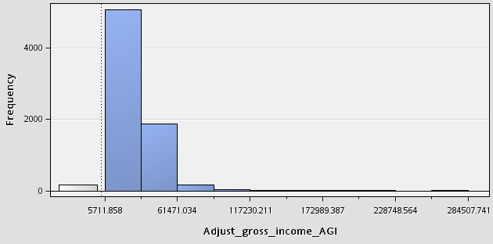
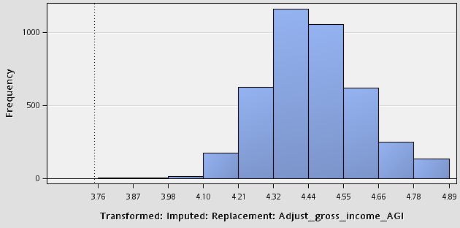
Explore/Validate and Repair selected inputs
This stage involved understanding underlying distribution of each selected inputs for:-
Normality, uniformity and skewness,
Range or standard deviation of inputs to detect outlying data points,
And finally the presence of missing data points. Certain modeling algorithms are very sensitive to these issues e.g.. Regression and Neural Network .
Outlying data points
Removed outliers three standard deviation from mean
Median imputation
Apply Log to base 10 transformation to normalize the data
Missing data points
Right skewed distribution
Before repairs
After repairs and Transformation

Slide 11
Splitting Modeling Dataset
Split the modeling dataset into two part:-
Training - This dataset is used to estimate the model’s parameters
Validation - This is an independent dataset to test and calibrate the parameter estimate and also used to select the ultimate model using fit statistics on the validation dataset.
There should be little separation between the training estimates and the validation estimates. Huge separation is an indication of model over fitting
Validation Sample in LSM ~ 45%
Training Sample in LSM 55%

Slide 12
Applying the appropriate modeling method
I explored two modeling methods in the LSM :-
Decision Tree Model – Produces prediction rules , e.g.
*------------------------------------------------------------*
Node = 5
*------------------------------------------------------------*
if Replacement: Bad Versus Good Credit < 961.5 or MISSING
AND Replacement: AVG TRD AVG MAXDEL 60 IN 24M >= 6.5 or MISSING
then
Tree Node Identifier = 5
Number of Observations = 924
Predicted: dep_var=0 = 0.45
Predicted: dep_var=1 = 0.55
Logistic Regression Model

Slide 13
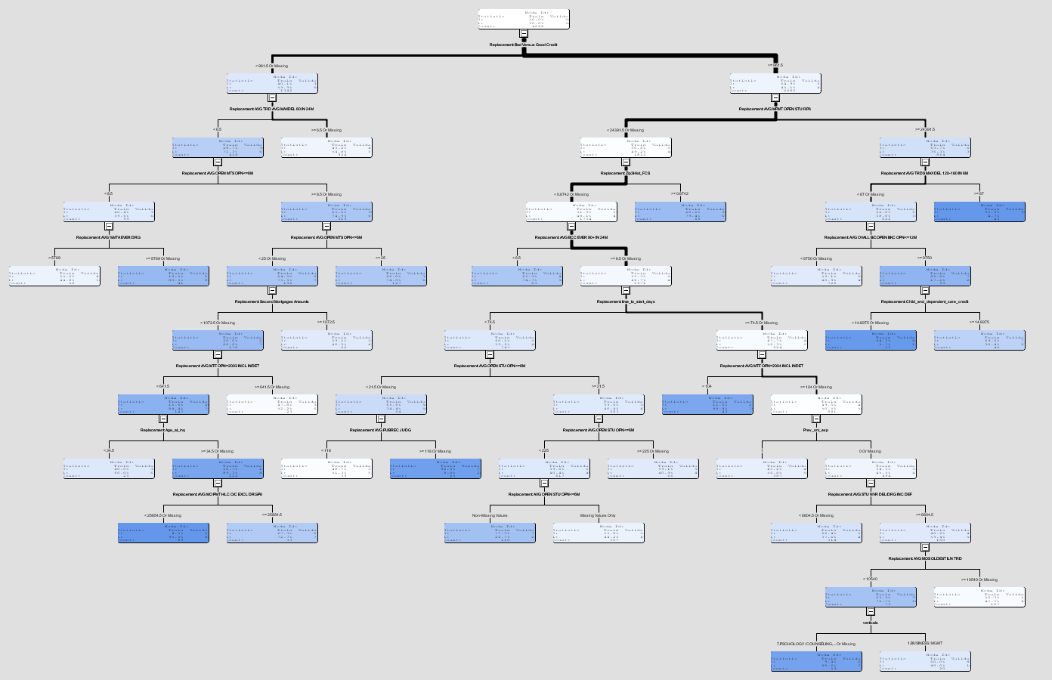
Cont’d Applying the appropriate modeling method

Slide 14
Cont’d Applying the appropriate modeling method
Logistic Regression Model :- Produces a prediction formula
E.g.. Prediction Estimate =W + W1X1 +W2X2 + etc………..
Intercept
weights
Inputs
score=
1/(1+1/EXP( -0.3061 +
PCTL_IMP_REP_Zip3Hist_FCS *0.27380087 +
PCTL_IMP_REP_time_to_start_days * 2.14603878 +
PCTL_IMP_REP_recent_Months_Since * 1.08856291 +
PCTL_IMP_REP_bad_versus_good_cre * -0.28203980 +
PCTL_IMP_REP_avg_mpmt_open_stu_r * -0.29473888 +
PCTL_IMP_REP_Age_at_inq * 0.01516530 +
PCTL_IMP_REP_avg_rtr_ever_90_ * 0.00001567 +
));

Slide 15
Cont’d Applying the appropriate modeling method
Logistic Regression Model with stepwise as variable selection criteria process
Inputs
No: fails 95% entry significance level test
Yes: pass 95% entry Significance level test
Rejected
Enter Input1
Enter Input2
Input1 stay or leave given input2 presence
Stay: if passes 95% stay Significance level test

Slide 16
Cont’d Applying the appropriate modeling method
Compare Fit Statistics of the two models
Logistic Regression
Decision Tree
Fit statistics a statistical measure of model performance
The most popular Fit statistics in model selection
Misclassification rates :- the proportion of disagreement between prediction and outcome. Lower values are desirable.
Average Square error: Squared difference between predicted and actual outcome and average over all cases. Lower values are desirable
Pick the model with the lowest Fit statistics to deploy
Logistic Regression won

Slide 17
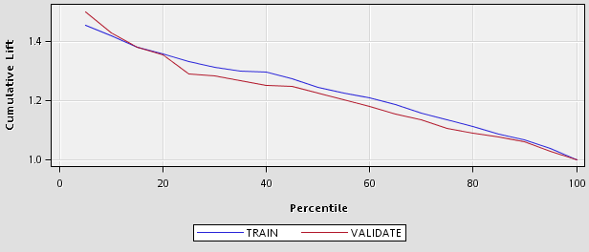
Model Results – Cumulative Lift Chart
The top 20% of cases have ~1.36 lifts. This means the proportion of Learner success and persistence in this top 20% is about 36% more likely than a randomly selected 20%.

Slide 18
Modeling Results – Variables effect and importance
Attribute in the model | Variable description | Effect | Variable Importance
IMP_REP_Zip3Hist_FCS |  | + | 14
LOG_IMP_REP_recent_Months_Since_ |  | + | 11
SQRT_IMP_REP_bad_versus_good_cre |  | - | 8
PWR_IMP_REP_avg_mpmt_open_stu_rp |  | - | 8
LOG_IMP_REP_time_to_start_days |  | + | 7
verticals | 5.Education | + | 6
SQRT_IMP_REP_HDHH65P |  | - | 5
PWR_IMP_REP_avg_stu_nvr_del_drg_ |  | + | 5
SQRT_IMP_REP_avg_mos_rcnt_mta_in |  | + | 4
IMP_REP_LifeT_Limt_ratio |  | - | 4
verticals | 4.Nursing | - | 4
IMP_Prev_onl_exp | 0 | - | 3
SQRT_IMP_REP_avg__iln_open_iln_r |  | - | 3
verticals | 2.Healthcare | + | 3
LOG_IMP_REP_avg_occ90_180_in24m_ |  | - | 3
SQRT_IMP_REP_avg_max_amt_open_il |  | - | 2
IMP_contact_probcell | 0 | + | 2
IMP_REP_avg_mos_oldest_iln_trd |  | - | 2
SQRT_IMP_REP_avg_mosrcnt_90_180_ |  | + | 2
PWR_IMP_REP_avg_aua_ever_60_ |  | - | 2
Public_Asst | 0 | + | 2
verticals | 3.Info Tech | + | 0
verticals | 6.Government / Public Service | - | 0
verticals | 1.Business / Mgmt | - | 0

Slide 19
Model’s Inference about Success and Persistence
The model describe a prospect learner’s likelihood of Success and Persistence as:-
living in a geographic area where Capella learners has historically higher First course success rate
Completed their last education long time ago
Has very good credit
Has lower student loan monthly payment and lower Student loans utilization
Has previous online education experience
Has a longer period of intended start date
Not receiving any kind of Public assistance
Academic interest is in Info Tech, Healthcare and Education

Slide 20
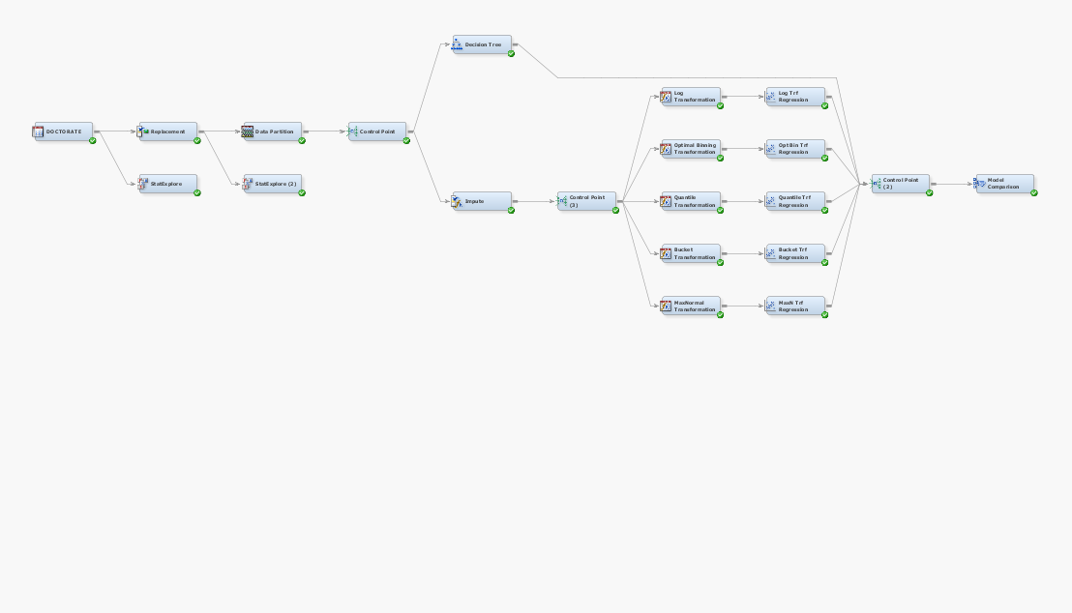
SAS Enterprise Miner Project Work Flow

Slide 21
Scoring Process Flow
Experian credit summarized data request via API
Rapleaf demographic & social Network data request via API
Lead Processing Engine a.k.a Seahawk
Scoring Algorithm
Probability scores
Segmented probability scores e.g. deciles
Inquirer Request
Zip historic files
Census data

Slide 22
SAS Enterprise Miner Project Work Flow

